Slide 1
Feature Engineering
Outlier Handling

Slide 2
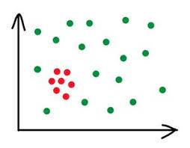
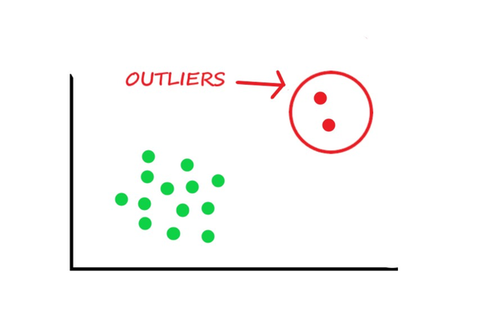
What is Outlier?
Outlier is a data object that deviates significantly from the rest of the data objects and behaves in a different manner.

Slide 3
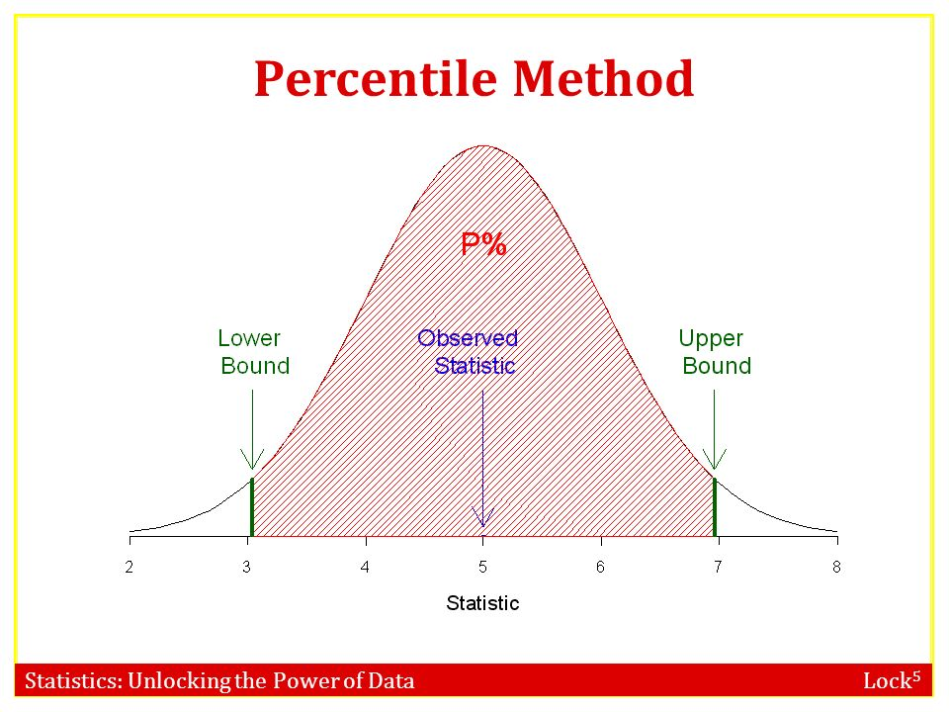
How to Remove Outliers ?
Using Percentile Technique

Slide 4
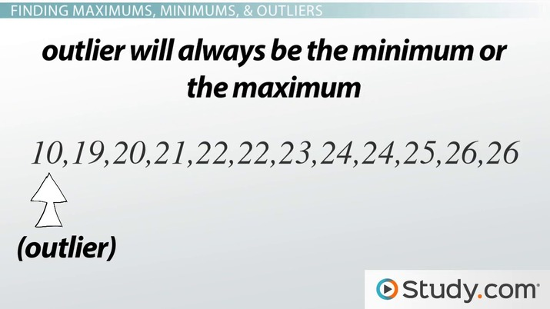
Feature Engineering

Slide 5
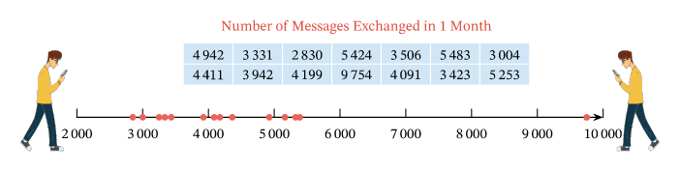

Slide 6
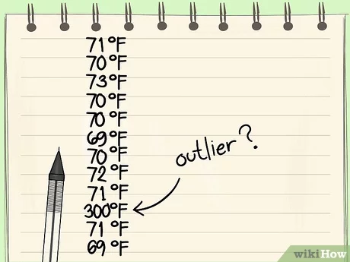

Slide 7
Let’s Code

